Slide 1



7th Edition of Bicycle Design Challenge -25
TEAM NAME | PEGASUS
TEAM ID | BDC205020
COLLEGE NAME | KNOWLEDGE INSTITUTE OF TECHNOLOGY-SALEM

Slide 2
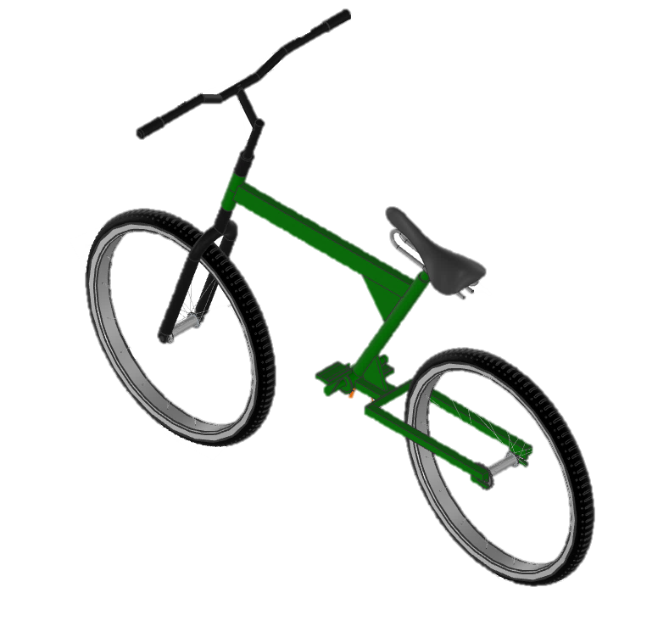
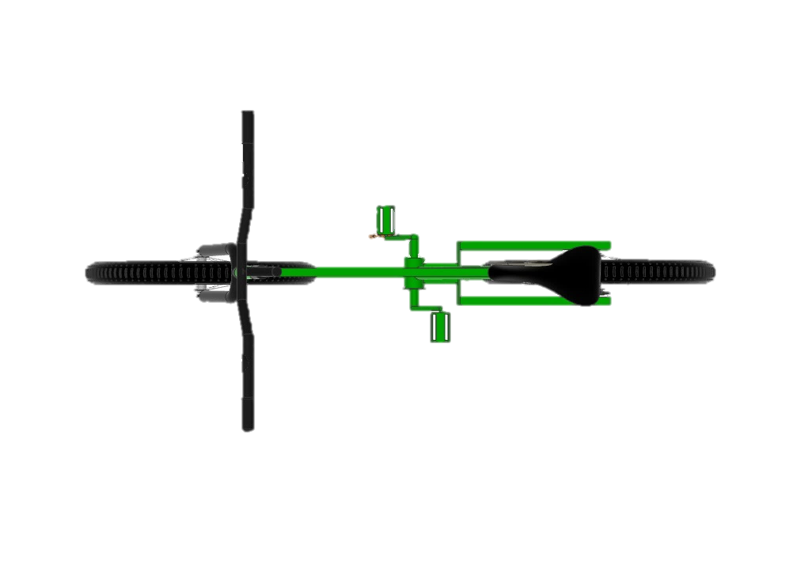
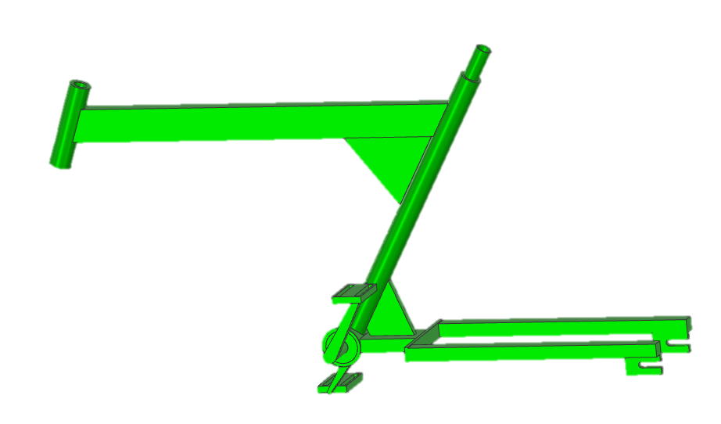
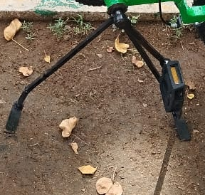
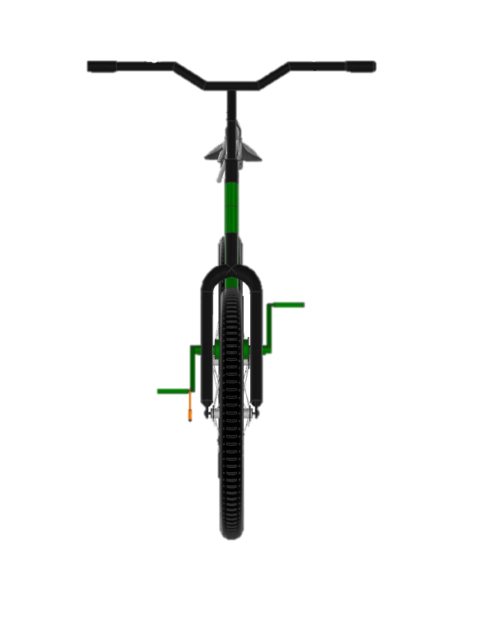
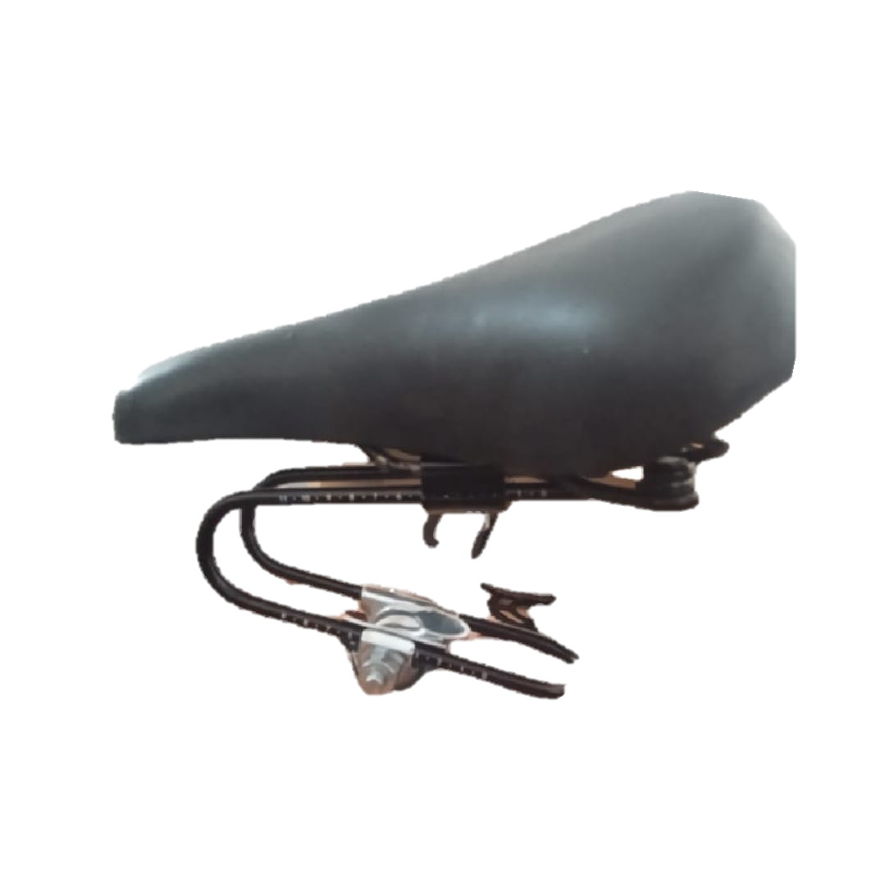
CONCEPT
Our goal is to design and build a Z-frame bicycle that is compact, reliable, and practical for everyday riders in today’s fast-paced lifestyle.
01
Z – FRAME STRUCTURE
02
PEDAL TO STAND
03
SEAT MOUNTED WITH SPRING SUSPENSION

Slide 3
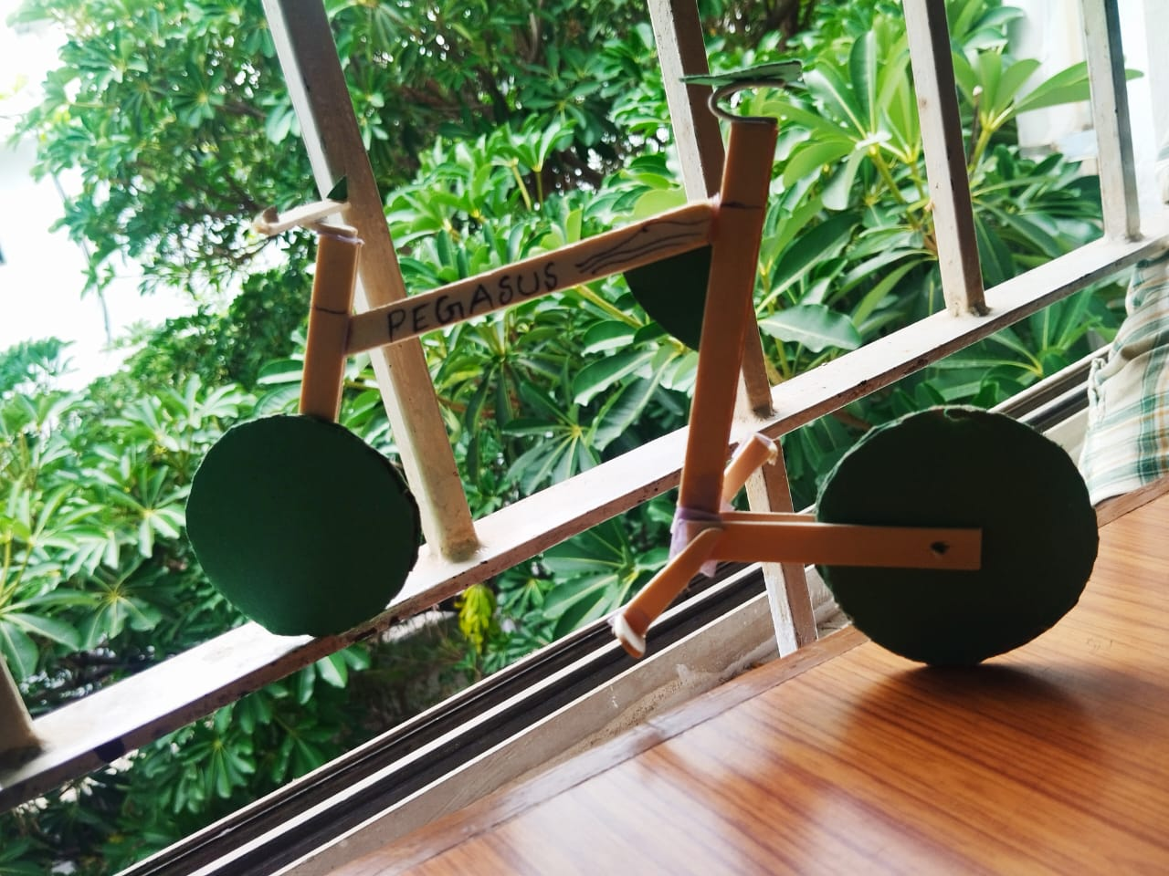
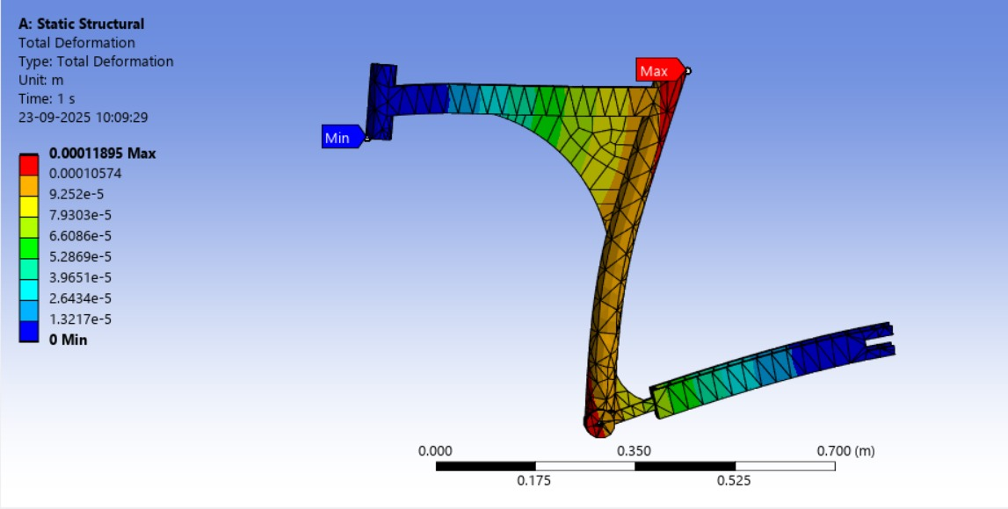
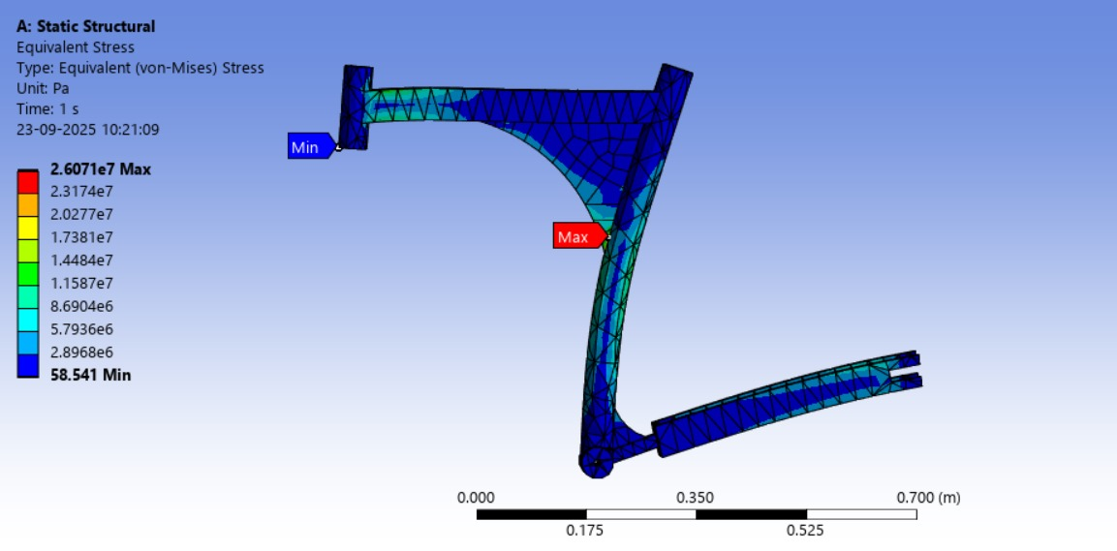
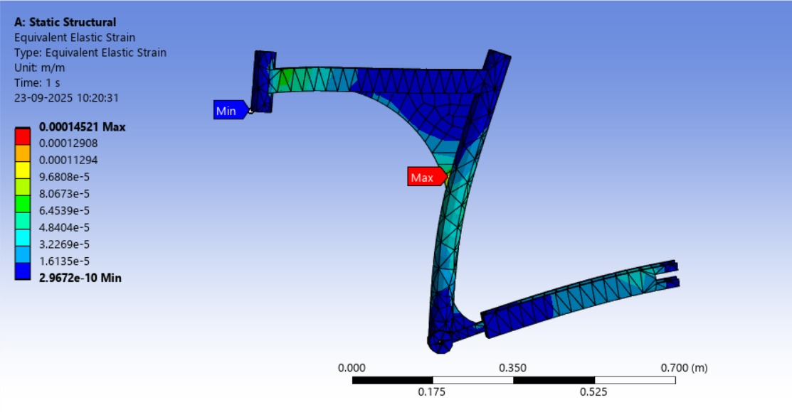
ENGINEERING DESIGN / FEA / PROTOTYPE
TOTAL DEFORMATION
EQUIVALENT STRESS
EQUIVALENT ELASTIC STRAIN
LOAD | DEFORMATION
1V (680) | 0.00011
2V (1360) | 0.00023
3V (2040) | 0.000356
LOAD | DEFORMATION
1V (680) | 6.9007
2V (1360) | 1.3801
3V (2040) | 2.0702
LOAD | DEFORMATION
1V (680) | 0.00012
2V (1360) | 0.00023
3V (2040) | 0.00037

Slide 4
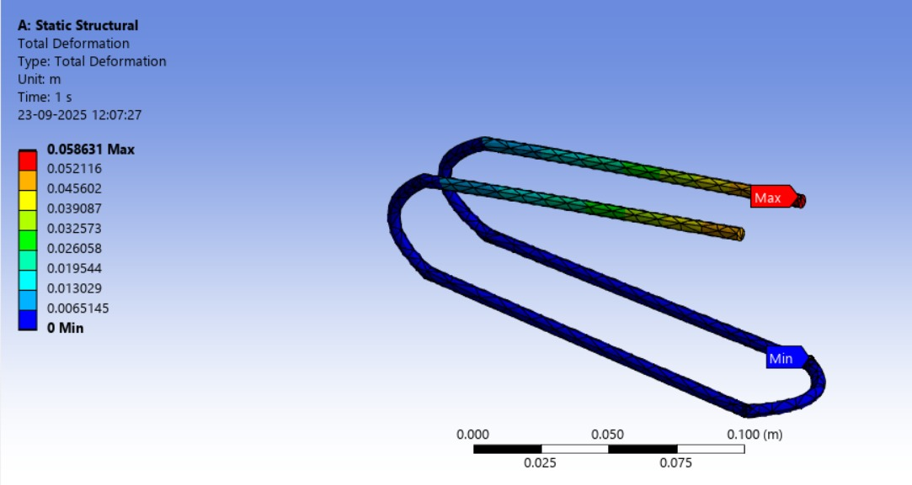
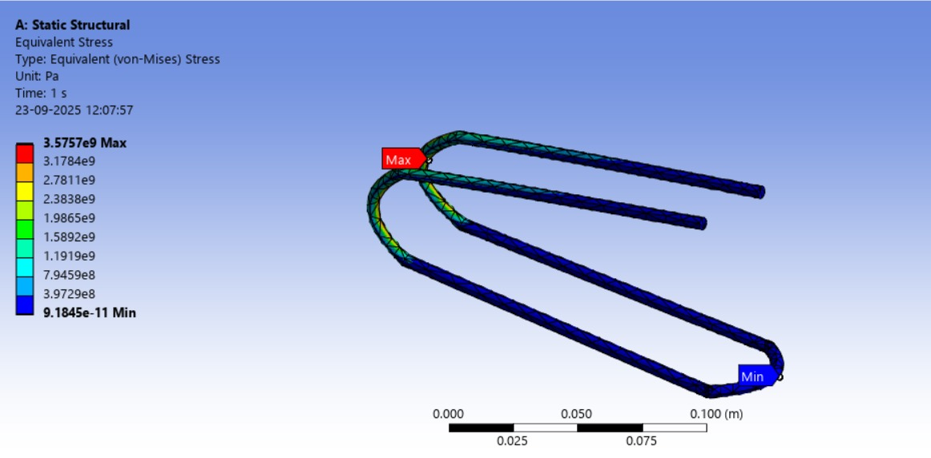
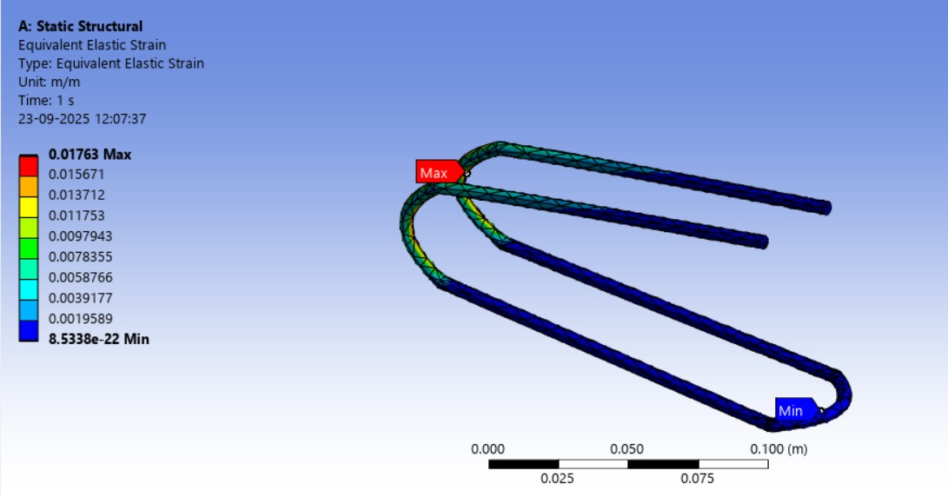
INNOVATION FEA PROCESS
TOTAL DEFORMATION
EQUIVALENT STRESS
EQUIVALENT ELASTIC STRAIN
LOAD | DEFORMATION
1V (680) | 0.058631
2V (1360) | 0.11726
3V (2040) | 0.17589
LOAD | DEFORMATION
1V (680) | 3.5757
2V (1360) | 7.1513
3V (2040) | 1.0727
LOAD | DEFORMATION
1V (680) | 0.01763
2V (1360) | 0.3526
3V (2040) | 0.0528

Slide 5
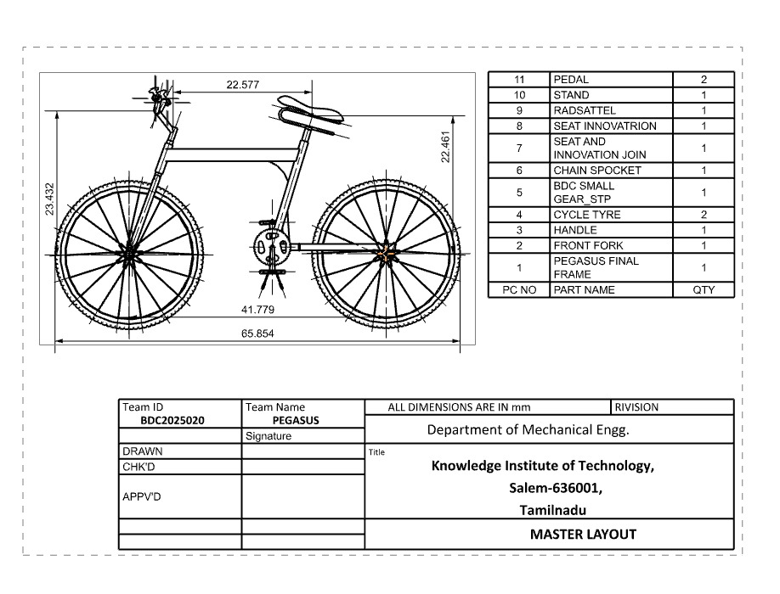
DIMENSIONAL CHECK / VALIDATION
TECHNICAL SPECIFICATION | RESPECTIVE VALUES
OVERALL DIMENSION | LENGTH : 1672mm HEIGHT : 595.17mm
WHEEL BASE | 1061.18 mm
TIRE SIZE | 26 INCHES
CENTRE OF GRAVITY | ~ (X,Y) = (38.8mm,15.0mm)
MATERIAL | MILD STEEL
MATERIAL GRADE | IS4130
WEIGHT | 16 kg
BREAK TYPE | V - BRAKE

Slide 6
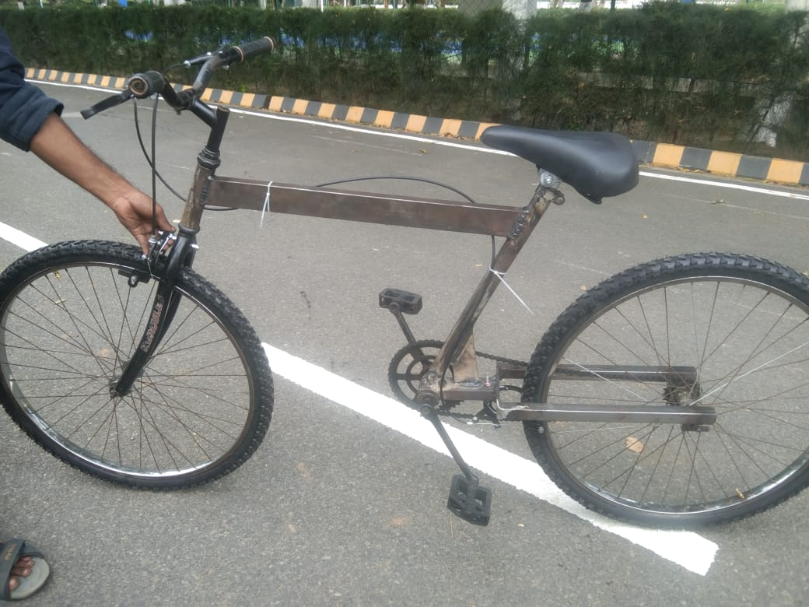

DESIGN OUTCOME
DESIGN MODEL : FAILURE : WE DESIGNED CYCLE DESIGN WITHOUT SUPPORT IN SEAT TUBE SO FACED PROBLEMS IN DEFORMATION IN (ANSYS)
DESIGN MODEL : SOLUTION : WE HAVE GIVEN SUPPORT IN SEAT TUBE FOR THE FRAME TO MODIFY THE PROBLEM

Slide 7
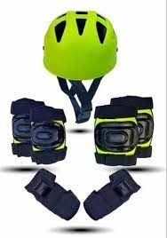
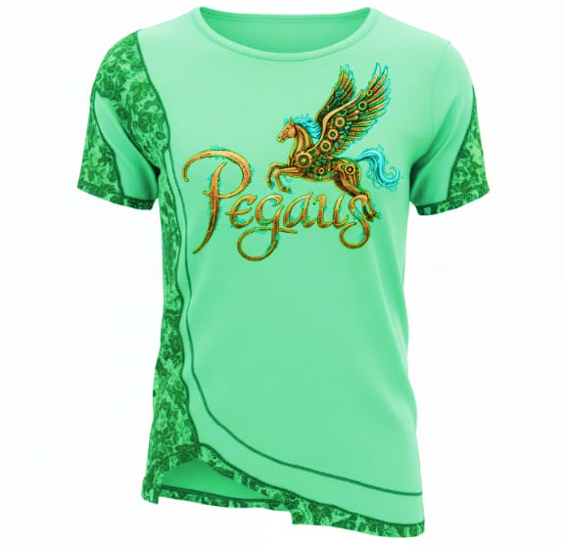
UNIQUE SELLING POINT OF BUSINESS IDEA
Fitness awareness through facts & health guidance
Safety-oriented fitness
equipment (T-shirts ,gear ,etc.)
Healthy consumables
(juice,
nuts)
Promotion of overall health & wellness
Affordable & convenient
offerings for fitness
enthusiasts

Slide 8
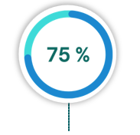
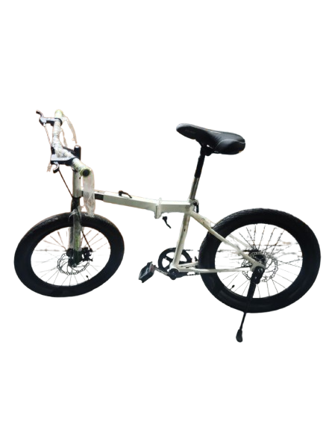
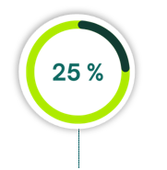
LESSONS LEARNT
WE LEARNT
MODIFICATION NEEDED
    Innovative Design
    Cost Efficiency
    Ergonomic Considerations
    CAE Process
    How to Reduce material usage.
    Weight Optimization
    Manufacturing Challenges
    Frame Design Refinement
    Project Planning and Execution
OUR OLD TEAM

